Slide 1
How have Georgia’s physical features affected its development?(8G1c)

Slide 2
Draw these features on your map.
Appalachian Mountains
Chattahoochee River
Savannah River
Fall Line
Barrier Islands
Okefenokee Swamp

Slide 3
As each slide is shown, write the information in the appropriate column of the chart on the back of your map.

Slide 4
Fall Line
Location
Importance
Separates the Piedmont from the Coastal Plain
Runs across the state and includes Columbus, Macon, and Augusta
Stopped earliest settlers from coming further inland, so many early settlements were here
Power source for earliest inhabitants through modern textile mills

Slide 5
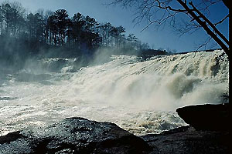
Small waterfalls like this are along the Fall Line.

Slide 6
Okefenokee Swamp
Location
Importance
Southeast Georgia
Outer Coastal Plain near Waycross and Folkston
Important ecosystem that is home to many species of animals, including some that are endangered
Attracts tourists and research scientists
Is the largest black water swamp in the U.S.

Slide 7
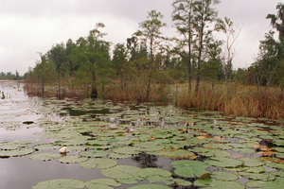
Dark waters of the Okefenokee Swamp

Slide 8
Appalachian Mountains
Location
Importance
Northeast Georgia
Also called Blue Ridge Mountains
Precipitation from here supplies water to whole state
Tourism brings visitors with money
Retirees move to area

Slide 9
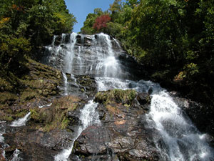
Amicalola Falls is the highest waterfall east of the Mississippi River.

Slide 10
Chattahoochee River
Location
Importance
Begins in the north Georgia mountains
Flows southwest to Atlanta and Columbus
Continues southward to Gulf of Mexico
Forms part of border with Alabama
Provides drinking water for Atlanta and other cities
Lakes (reservoirs) that are formed from it provide recreation – boating, fishing, skiing

Slide 11
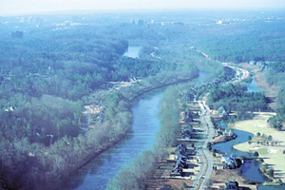
Chattahoochee River winds its way over much of our state.

Slide 12
Savannah River
Location
Importance
Forms border between Georgia and South Carolina
Empties into Atlantic Ocean
One of Georgia’s original boundaries
Port of Savannah – one in 7 jobs in GA relies on goods being shipped in or out of Savannah

Slide 13
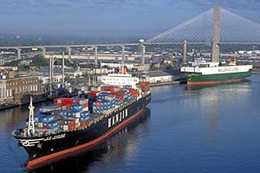
The Savannah River Port is the #2 export facility in the United States.

Slide 14
Barrier Islands
Importance
Location
Islands provide natural barrier to mainland from storms
Visitors take vacations on the islands
Important ecosystem – 1/3 of east coast’s salt marshes are on GA’s coast
Jekyll – state park
Cumberland – national seashore
Off Georgia’s mainland on the Atlantic coast

Slide 15
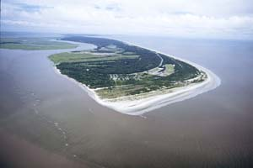
Jekyll Island – one of Georgia’s barrier islands

Slide 16
Ticket Out the Door
Pick one of the 6 physical features and tell me where it is located in Georgia and the importance of that feature on the development of Georgia.
Label your paper: TOD – Georgia’s physical features
Three to five complete, coherent sentences for full credit.

